Slide 1
Introduction to HTML5 and CSS3: Day 1 Dr. Naveen Kumar, BES-1

Slide 2
Agenda
Internet and World Wide Web
Web site, Web Browser and Web Server
URL
Hypertext, Hypermedia and Markup Language
Client/Server concept
HTTP and HTML
Web Page and Home page.
Two types of Searching

Slide 3
Internet and WWW
Global Interconnected networks of computers.
Network of networks consists of millions of private, public, academic, business networks.
Information resources over the internet inter-linked documents are WWW.
Network of Pages of text, image, sound, videos etc.

Slide 4
Web Site, Web Browser and Web Server
Web site is a collection of related web pages from the similar matter or domain.
Web Browser is a software to see web pages.
Web Server is a computer where web pages are kept. It provides requested resources as service so called Server.

Slide 5
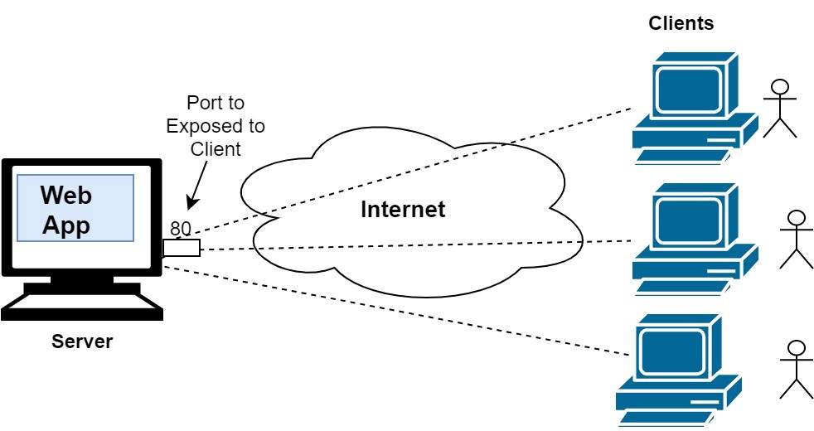

Slide 6
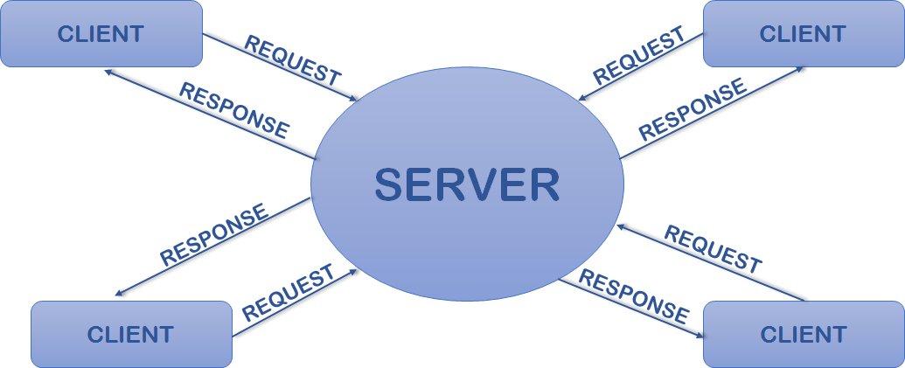

Slide 7
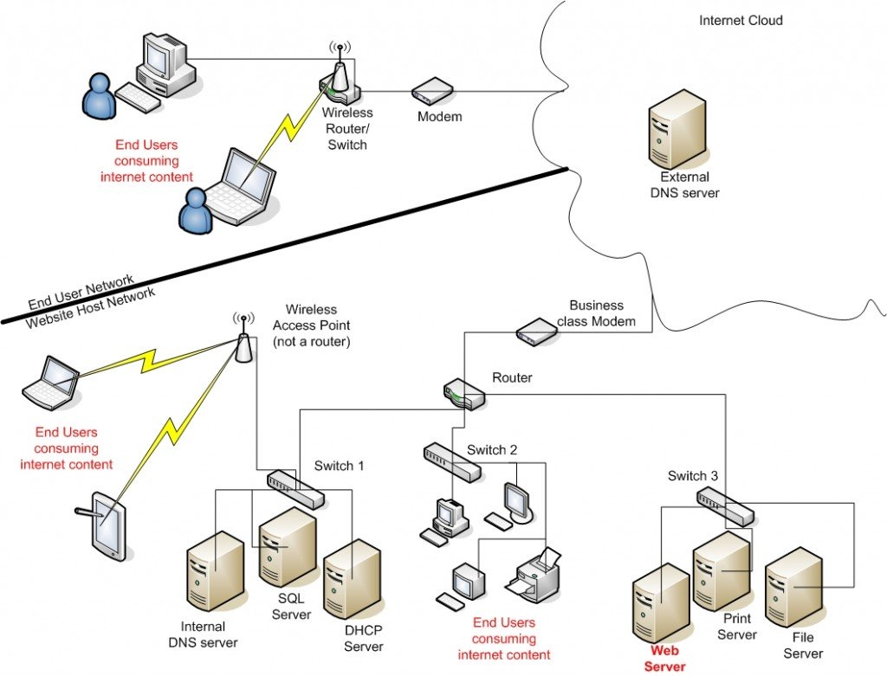

Slide 8
Uniform Resource Locator (URL)
These are the web addresses.
The resource locator is an addressing system.
Folders and Files etc.

Slide 9


Slide 10
Hypertext, Hypermedia and Markup Language
Text which contains links to other texts (coined by Ted Nelson in around 1965).
Hypertext not limited to only tesxt: it an include graphics, video and sound etc.
the global infrastructure which facilitates data transfer Semantic Components: Hyper Text Transfer Protocol (HTTP) Hyper Text Markup Language (HTML) Extensible Markup Language (XML) Uniform Resource Identifiers (URIs)

Slide 11
<!DOCTYPE html> <html> <head> <title>Page Title</title> </head> <body> <h1>This is a Heading</h1> <p>This is a paragraph.</p> </body> </html>

Slide 12
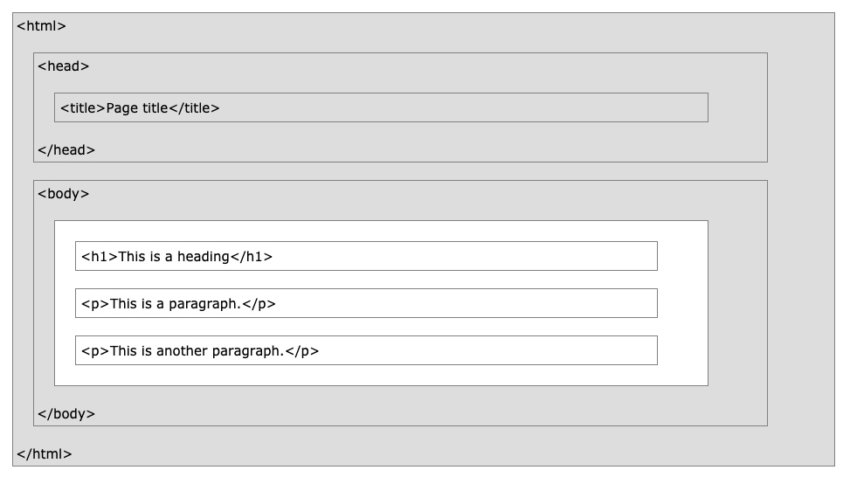

Slide 13
HTML is the standard markup language for Web pages.
With HTML you can create your own Website.
This tutorial follows the latest HTML5 standard.

Slide 14
An HTML element is defined by a start tag, some content, and an end tag:
<tagname>Content goes here...</tagname>
The HTML element is everything from the start tag to the end tag:
<h1>My First Heading</h1>
<p>My first paragraph.</p>

Slide 15
Thank you

